Slide 1
Build Smarter Applications with Microsoft AI
Cassie Breviu
Cloud Developer Advocate

Slide 2

Cassie Breviu
Cloud Developer Advocate at Microsoft
Twitter me @cassieview
aka.ms/iltaAI

Slide 3
Agenda
What is Machine Learning? Let’s look under the hood – It’s not magic!
Adding Humanlike Capabilities to apps with Cognitive Services
What is NLP and how do I create a bot?
Making Sense of Unstructured Data
Azure Machine Learning Studio
aka.ms/iltaAI

Slide 4
What is AI, ML and DL?
Artificial intelligence (AI) is a technique that enables computers to mimic human intelligence. It includes machine learning.
Machine learning (ML) is a subset of artificial intelligence that includes techniques (such as deep learning) that enable machines to improve at tasks with experience.
Deep learning (DL) is a subset of machine learning based on artificial neural networks that permit a machine to train itself.
aka.ms/iltaAI

Slide 5
When should you use machine learning?
Regression: how much / how many
supervised
learning
Classification: which class does it belong to?
Clustering: are there different groups? which does it belong to?
unsupervised
learning
Anomaly Detection: is this weird?
Recommendation: which option should I choose?
aka.ms/iltaAI

Slide 6

brohrer.github.io/blog.html
aka.ms/IitaAI

Slide 7
Computer Vision Convolutional Neural Network
dog
bicycle
apple
tennis ball

Slide 8

Trained Convolutional NN
dog
0.01
02
bicycle
0.83
apple
0.09
tennis ball
0.07

Slide 9

aka.ms/iltaAI

Slide 10
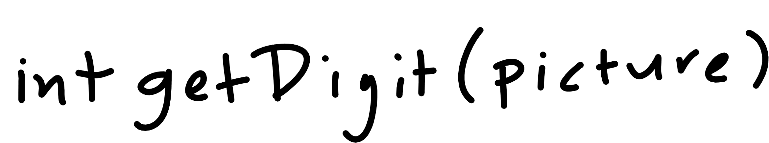
aka.ms/iltaAI

Slide 11

aka.ms/iltaAI

Slide 12
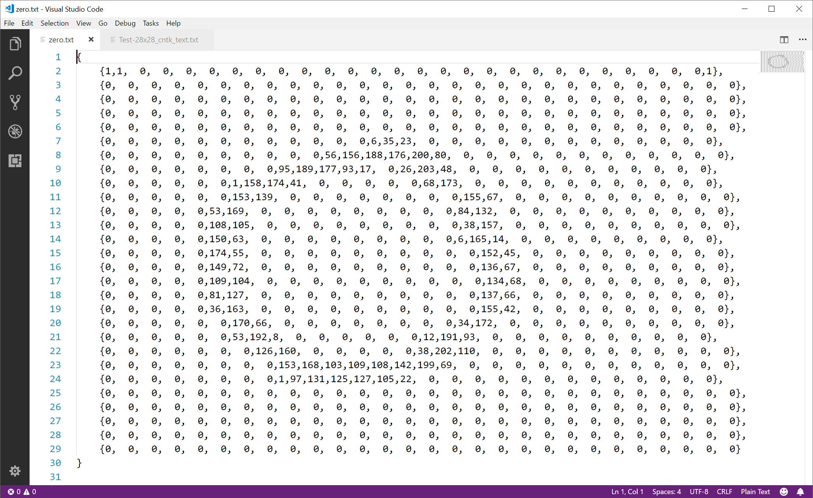

Slide 13
Programming
Algorithm
Answers
Data
aka.ms/iltaAI

Slide 14
Machine Learning
Answers
Algorithm
Data
aka.ms/iltaAI

Slide 15
Machine Learning
Answers
Model
Data
aka.ms/iltaAI

Slide 16
Machine Learning
Answers
Model
Data
aka.ms/iltaAI

Slide 17
Machine Learning
Answers
Data
Model
Predictions
Data
aka.ms/iltaAI

Slide 18

aka.ms/iltaAI

Slide 19
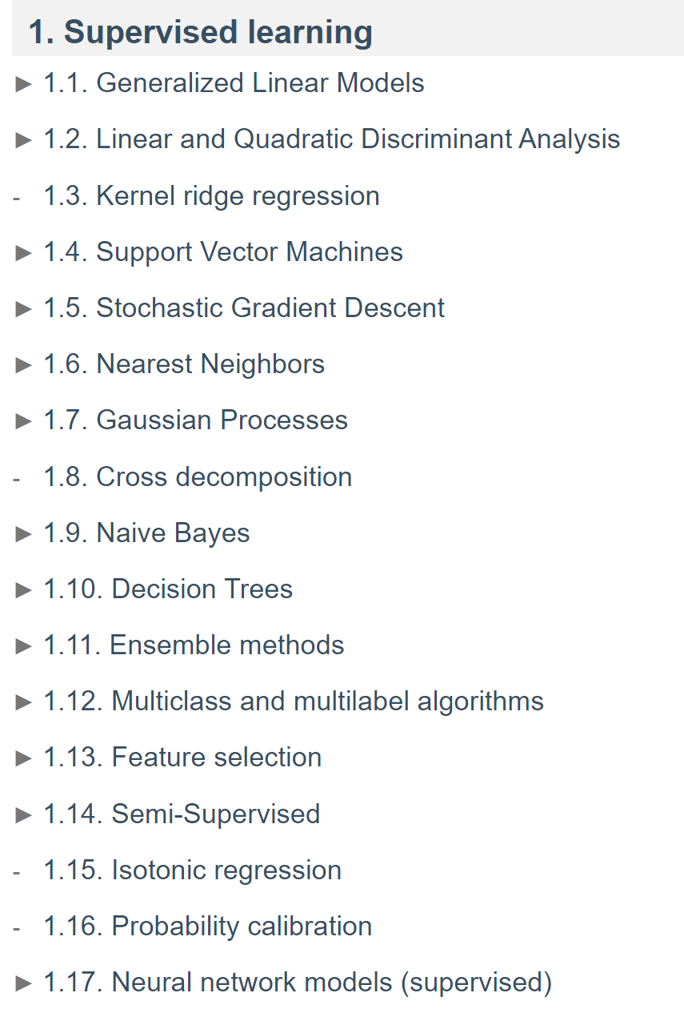
scikit-learn – classifiers
source: https://scikit-learn.org/stable/user_guide.html
aka.ms/iltaAI

Slide 20
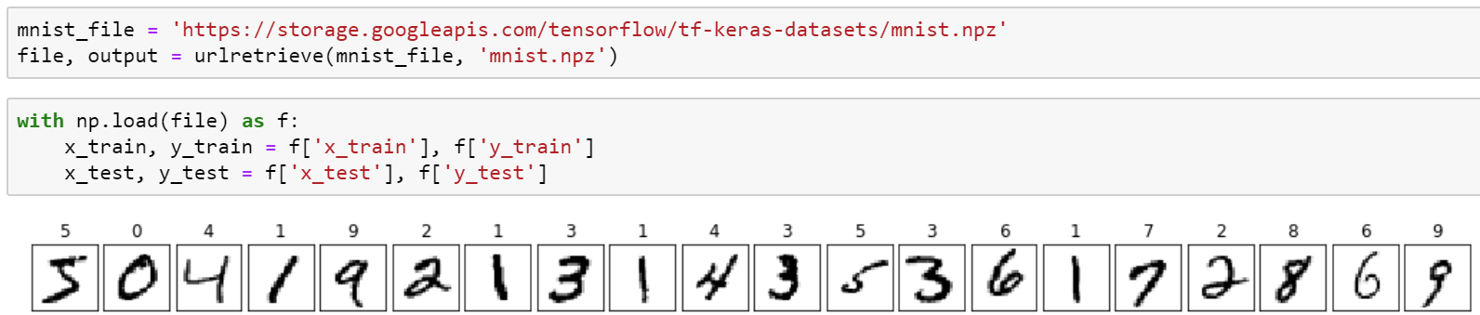
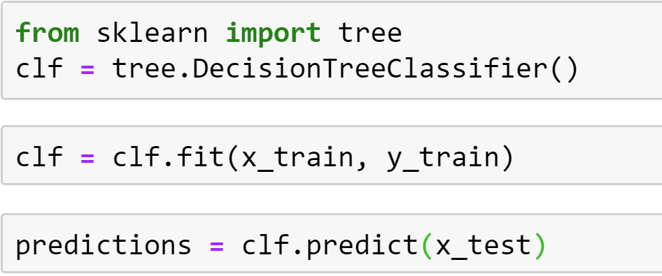
scikit-learn – concepts
You “pick” the function “shape” – in scikit-learn these are called classifiers
You “fit” the data to the classifier
You use the classifier to predict

Slide 21



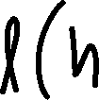

TensorFlow – concepts
model – the function shape we construct
cost/loss function – a function that tells us how bad we are at predicting
optimizer – method for reducing how bad we are at predicting

Slide 22
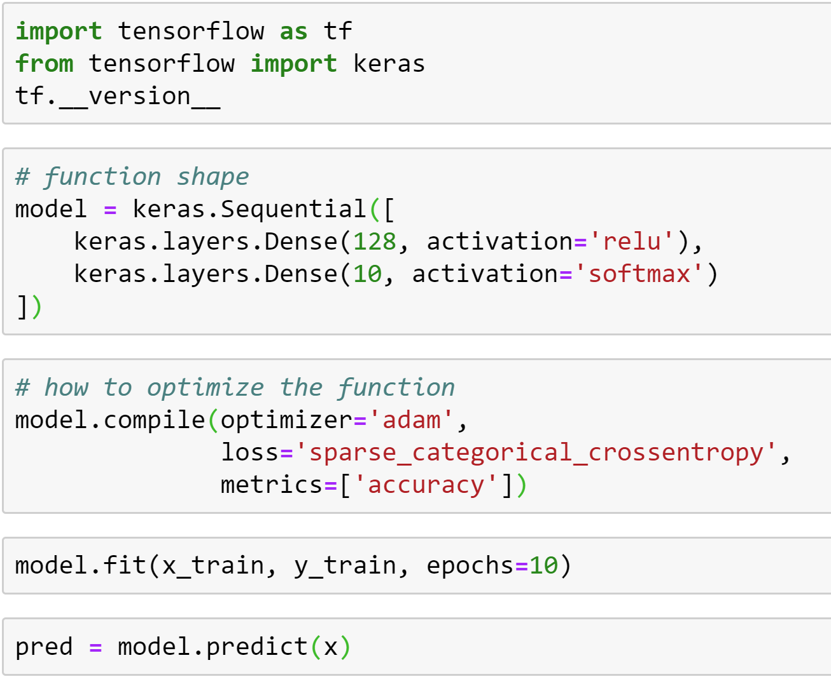
TensorFlow – concepts
You “craft” the function “shape” – in TensorFlow this is a model
You “optimize” the model using a cost/loss function and optimizer
You use the model to predict

Slide 23
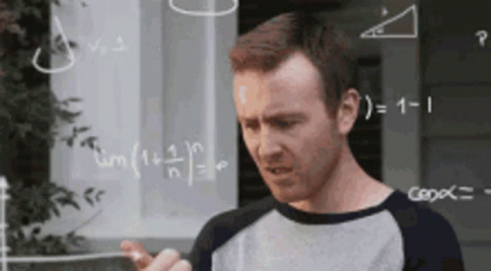

Slide 24

But you don’t have to do any of that!

Slide 25
Overview of Azure Cognitive Services
aka.ms/iltaAI

Slide 26






Azure Cognitive Services
Vision
Speech
Language
Decision
Search
Recognize, identify, caption, index, and moderate your pictures, videos, and digital ink content.
Convert spoken audio into text, use voice for verification, or add speaker recognition to your app.
Allow your apps to process natural language with pre-built scripts, evaluate sentiment and learn how to recognize what users want.
Build apps that surface recommendations for informed and efficient decision-making.
Add Bing Search APIs to apps and harness the ability to comb billions of webpages, images, videos, and news with a single API call.
Give your apps a human side
aka.ms/iltaAI

Slide 27
Adding humanlike capabilities to apps
Vision, speech, understanding and more

Slide 28
Enhance apps with humanlike capabilities
Conversational interfaces (in text or speech)
Captions for photos / search photos by content
Customize user interfaces according to individual behaviors
Translate text or speech into the user’s language
Identify spikes or other unusual behavior in sensor logs
aka.ms/iltaAI

Slide 29
Demo
Cognitive Services Computer Vision
aka.ms/IitaAI

Slide 30
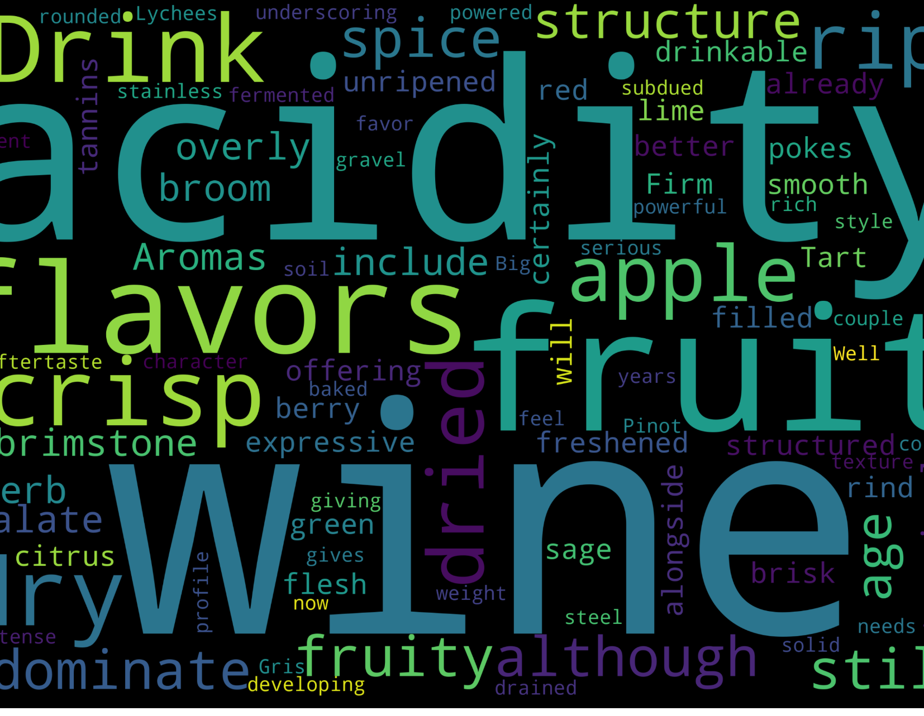
How does NLP work?

Slide 31
Common Text Processing Steps
Sentence or Word Tokenization
Text Lemmatization and Stemming
Remove Stop Words
N-Gram
Spell Check, Lowercase, Regex and Remove Special Characters
aka.ms/iltaAI

Slide 32
“Bag of Words” text processing
Vocabulary Dictionary also called Tokens
Aromas | Flavors | Fruit | Palate | Wine
1 | 0 | 1 | 1 | 0
1 | 0 | 0 | 1 | 0
0 | 0 | 1 | 1 | 1
Aromas include tropical fruit, broom, brimstone and dried herb. The palate isn't overly expressive, offering unripened apple, citrus and dried sage alongside brisk acidity.
Here's a bright, informal red that opens with aromas of candied berry, white pepper and savory herb that carry over to the palate. It's balanced with fresh acidity and soft tannins.
This wine shows off Yountville fruit at its finest, starting with a floral component to the nose. Spicy, bright and lifted, it coats the palate in ripe berry and cherry, ending with a snap of vanilla.

Slide 33
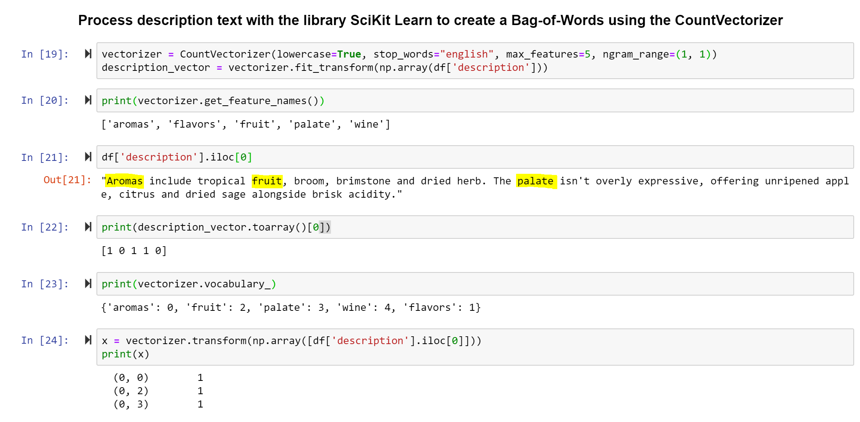
aka.ms/iltaAI

Slide 34
But you don’t have to do any of that!

Slide 35

Lets talk about Bots!
QnA Bot Maker
Luis.ai
Power Virtual Agent
Language Cognitive Services
…and more!
aka.ms/iltaAI

Slide 36
Demo
Language Cognitive Services

Slide 37
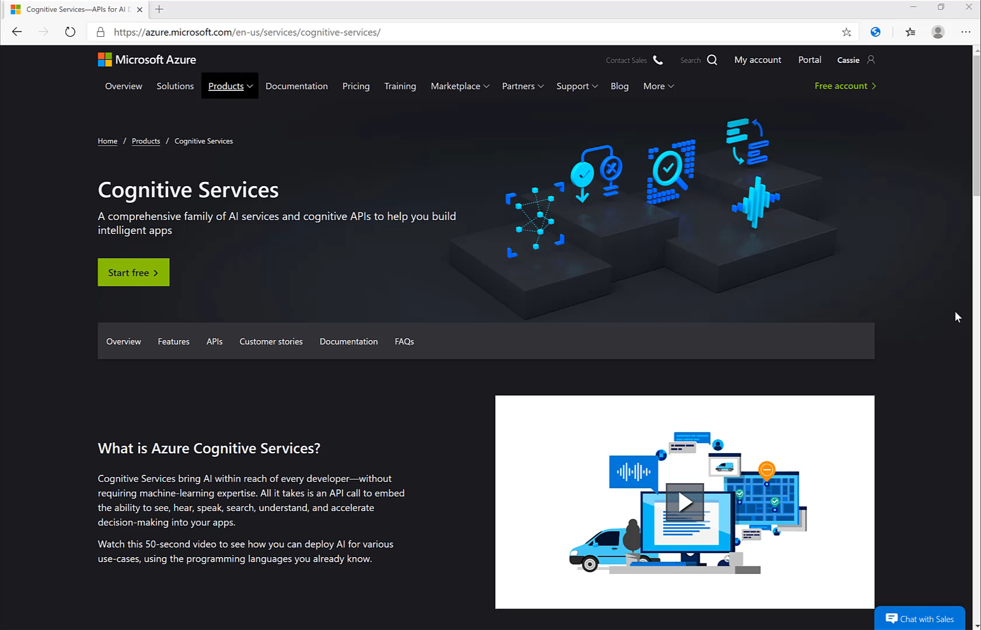

Slide 38
Demo
QnA Bot Maker

Slide 39
Making Sense of your Unstructured Data with AI
aka.ms/iltaAI

Slide 40
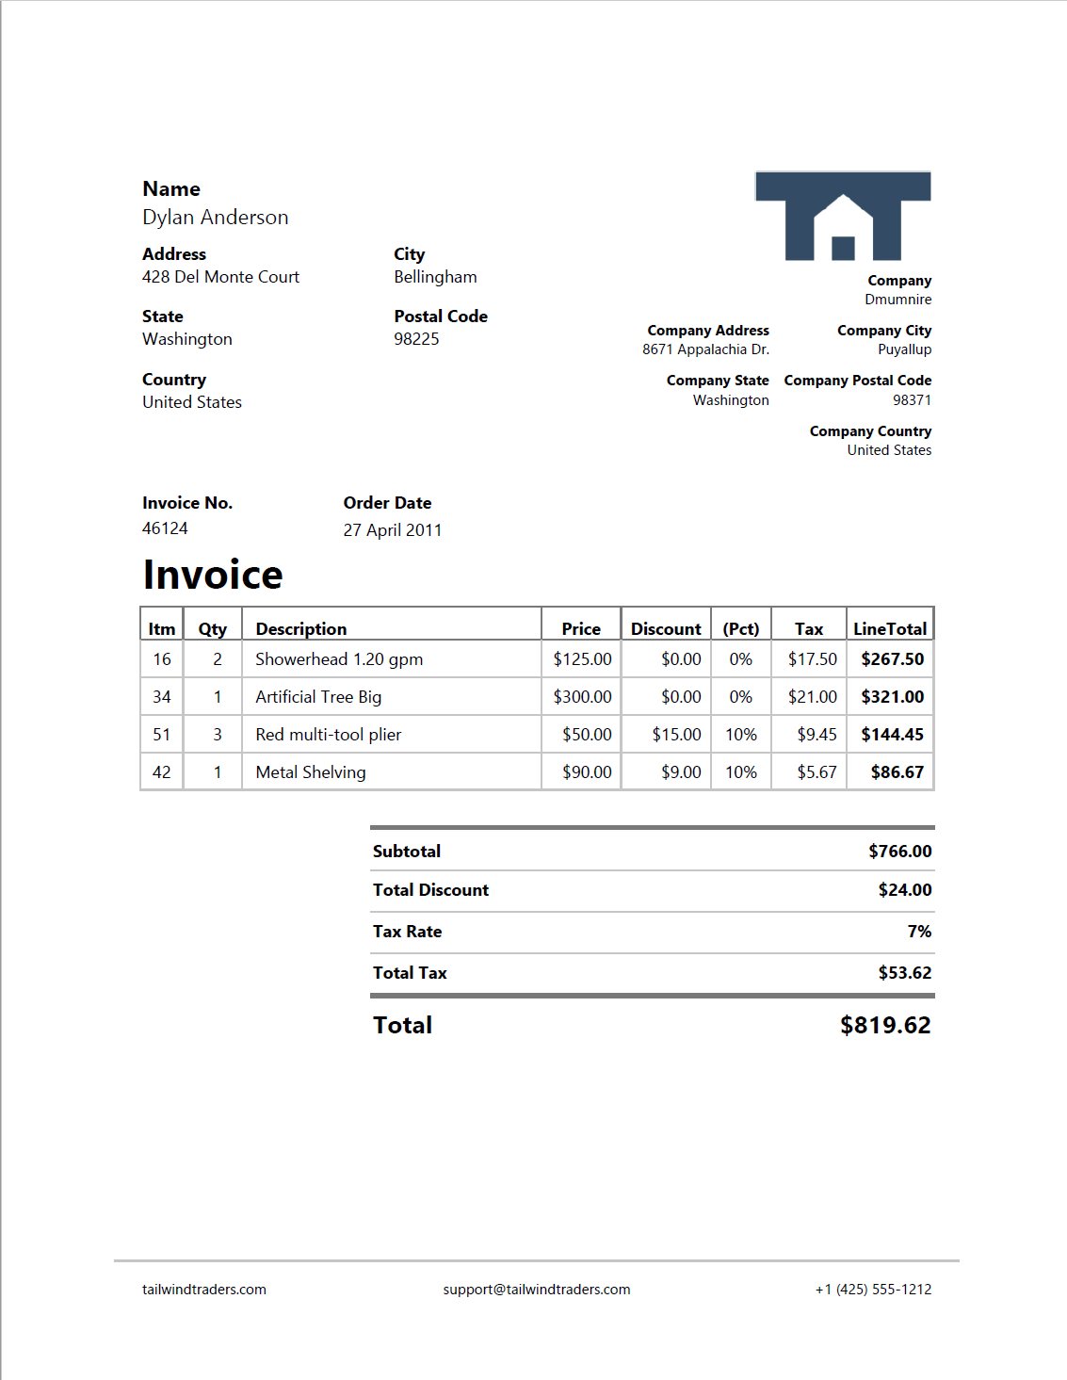
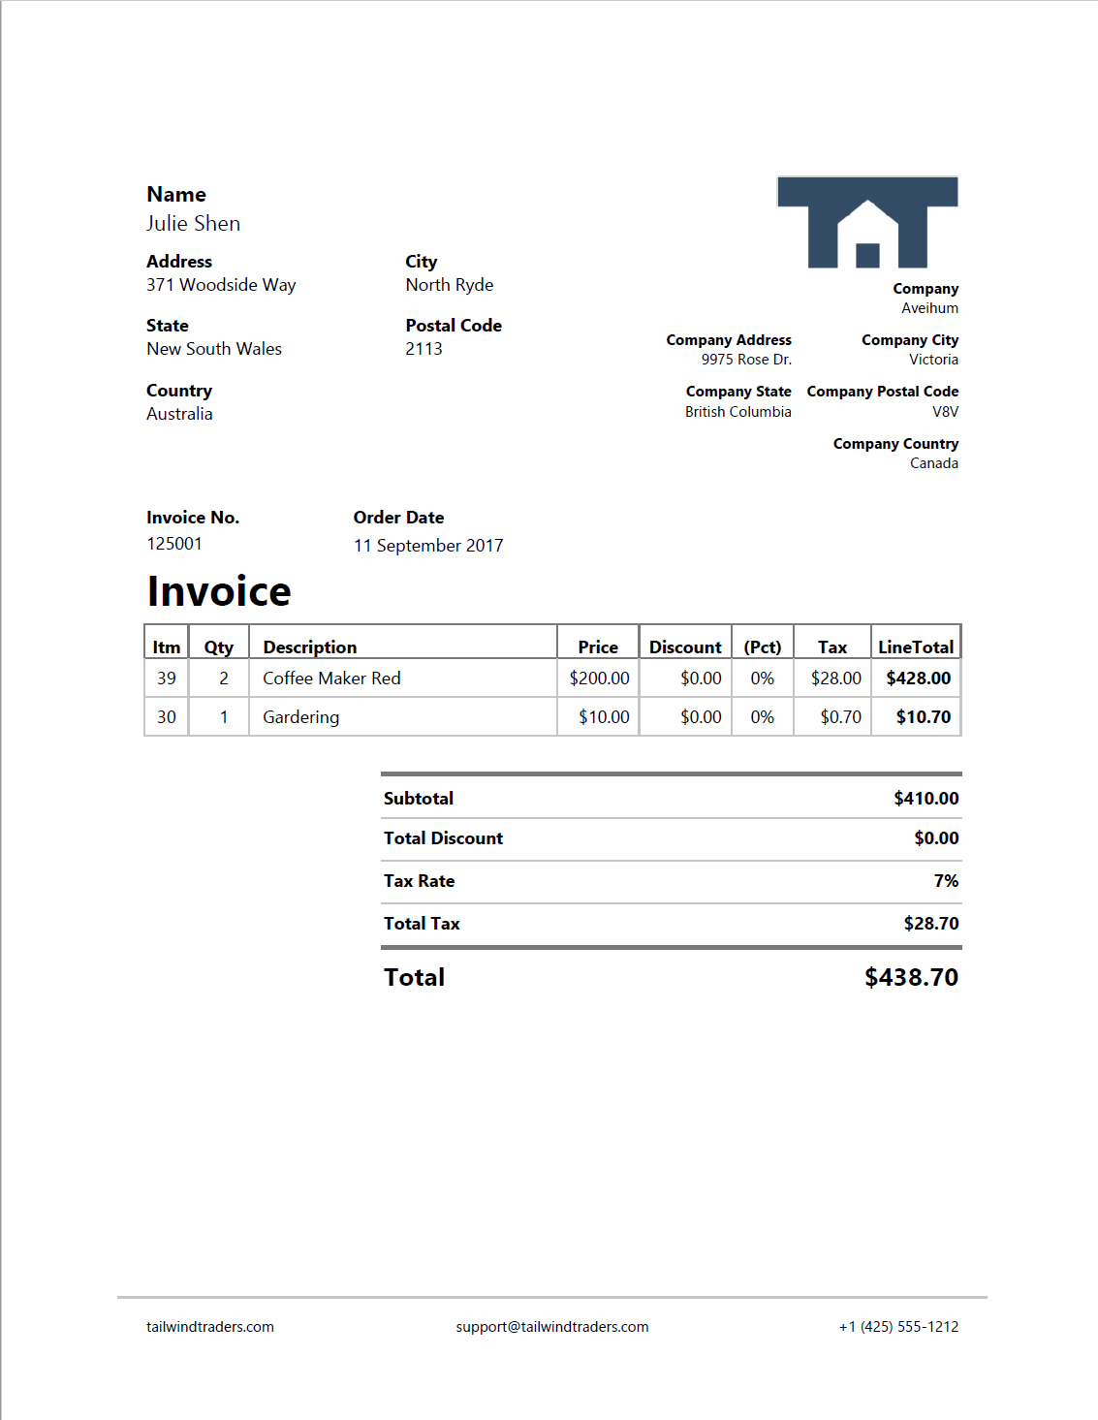

aka.ms/iltaAI

Slide 41
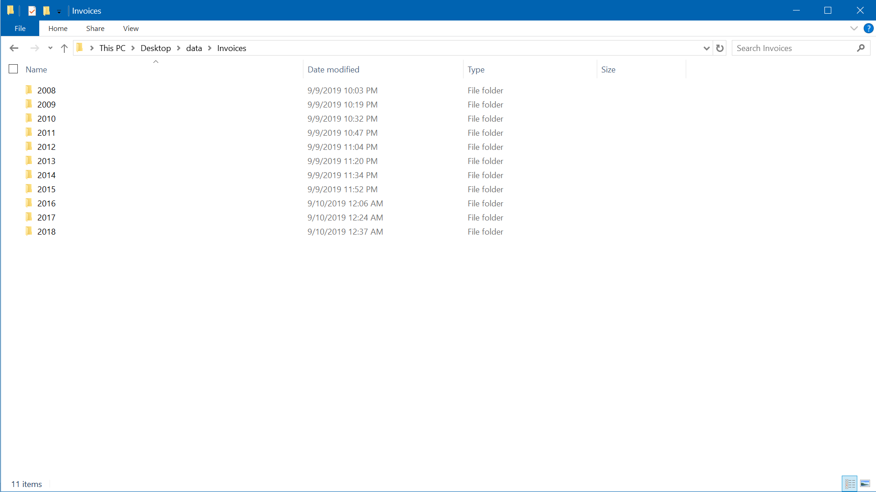
aka.ms/AIML10
aka.ms/iltaAI

Slide 42
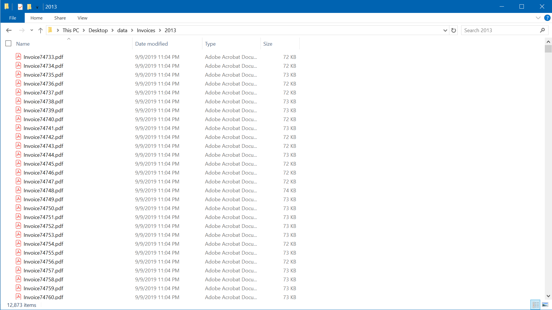

Slide 43
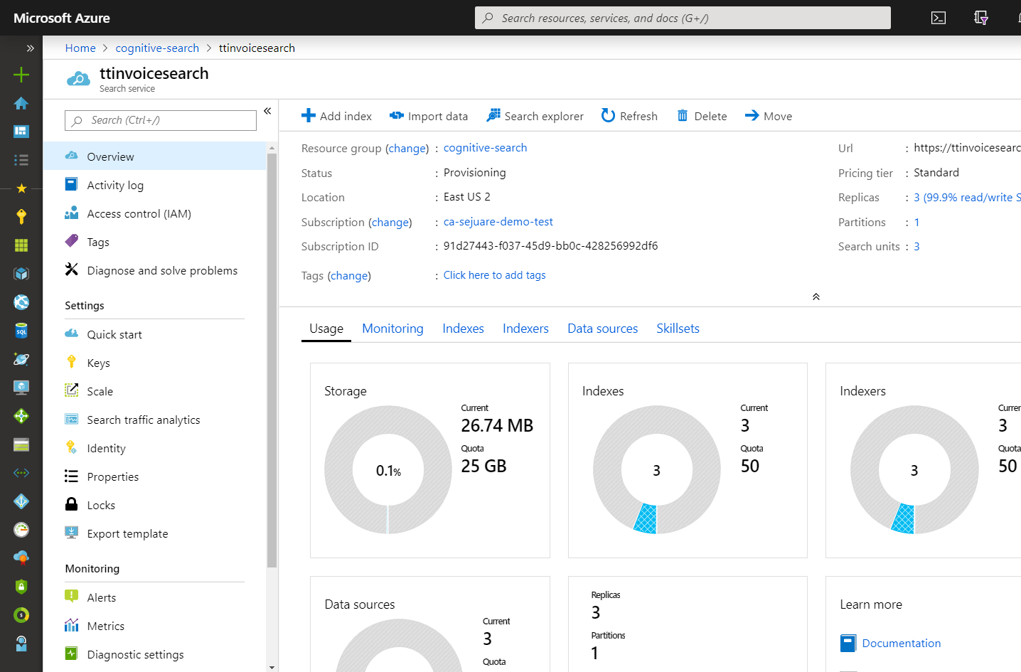
Azure Cognitive Search
Search-as-a-Service
management free
keyword search
faceting
language analyzers
geospatial support
suggestions
auto-complete
customizable scoring
proximity search
Synonyms
cognitive search
…and more!

Slide 44
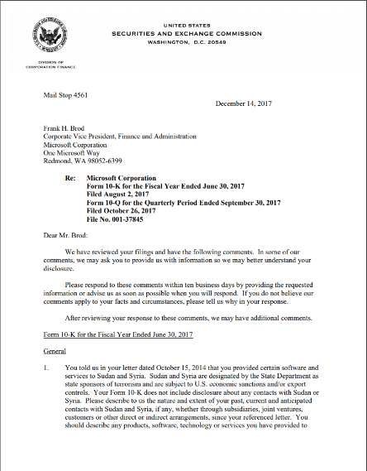
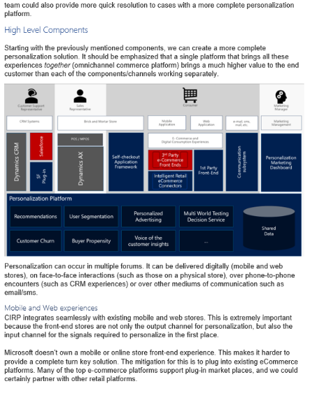
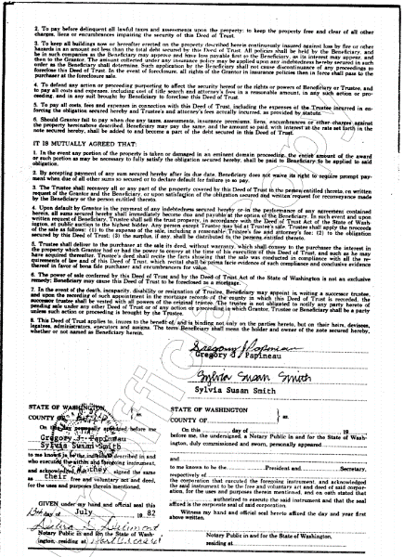
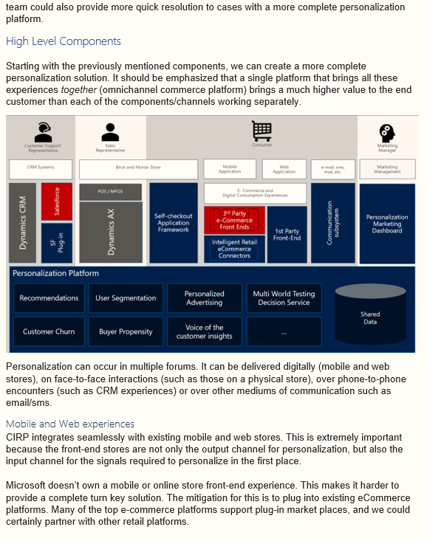
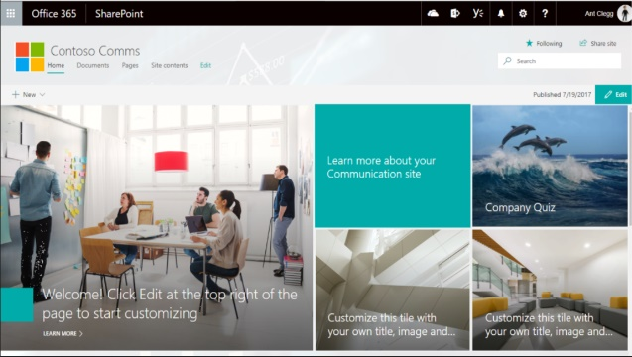



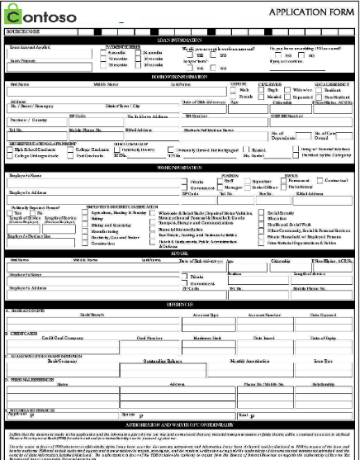
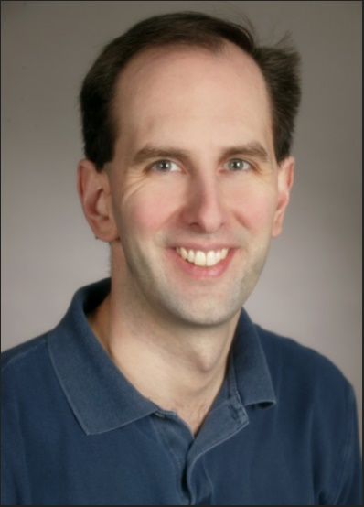
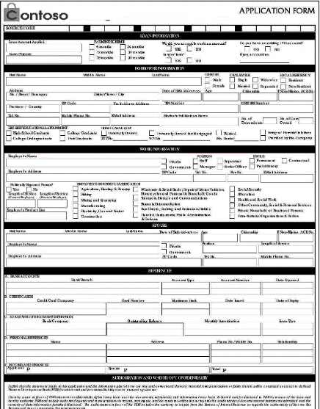
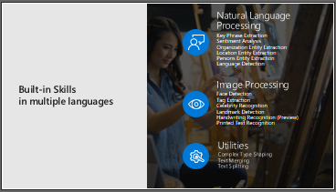
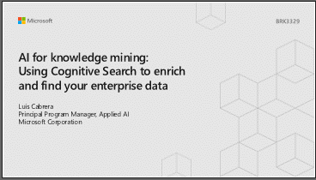

TIFF
HTML
…
Scott Guthrie
JPG
aka.ms/AIML10
aka.ms/iltaAI
#MSIgniteTheTour

Slide 45
Pattern
INGEST
ENRICH
EXPLORE
Cognitive skills
Data in any
format, any
Azure store
Search
Annotations
aka.ms/AIML10
aka.ms/iltaAI

Slide 46

Zooming in…
IEnricher
IEnricher
Cognitive Skill
Document Cracking
Skillset:
Extensible enrichment
pipeline
Source Data
Enriched Documents
Search Index
INGEST
ENRICH
EXPLORE

Slide 47
Ingest
Built-in connectors
Blob Storage
Azure SQL
Cosmos DB
Azure Tables
MySQL
Azure Files
ADLS Gen2
text
Document Cracking
metadata
Source Data
Formats
pdf, rtf, doc
jpg, xml, json
ppt, tiff, png
html, xls, bmp
images
aka.ms/AIML10

Slide 48
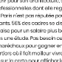



Enrich
Information
Cutting-edge AI
Fully text-searchable rich index
Key Phrase extraction
Location entity extraction
Sentiment analysis
text
Organization entity extraction
Persons entity extraction
Language detection
metadata
Face detection
Celebrity recognition
Tag extraction
images
Custom skills
Landmark detection
Printed text recognition
INGEST
ENRICH
EXPLORE

Slide 49

Enrich – Sample Skillset
text
organization entity recognition
merge text
printed text recognition
location entity recognition
object detection
persons entity recognition
images
face detection
Custom Skill
aka.ms/AIML10
aka.ms/iltaAI

Slide 50
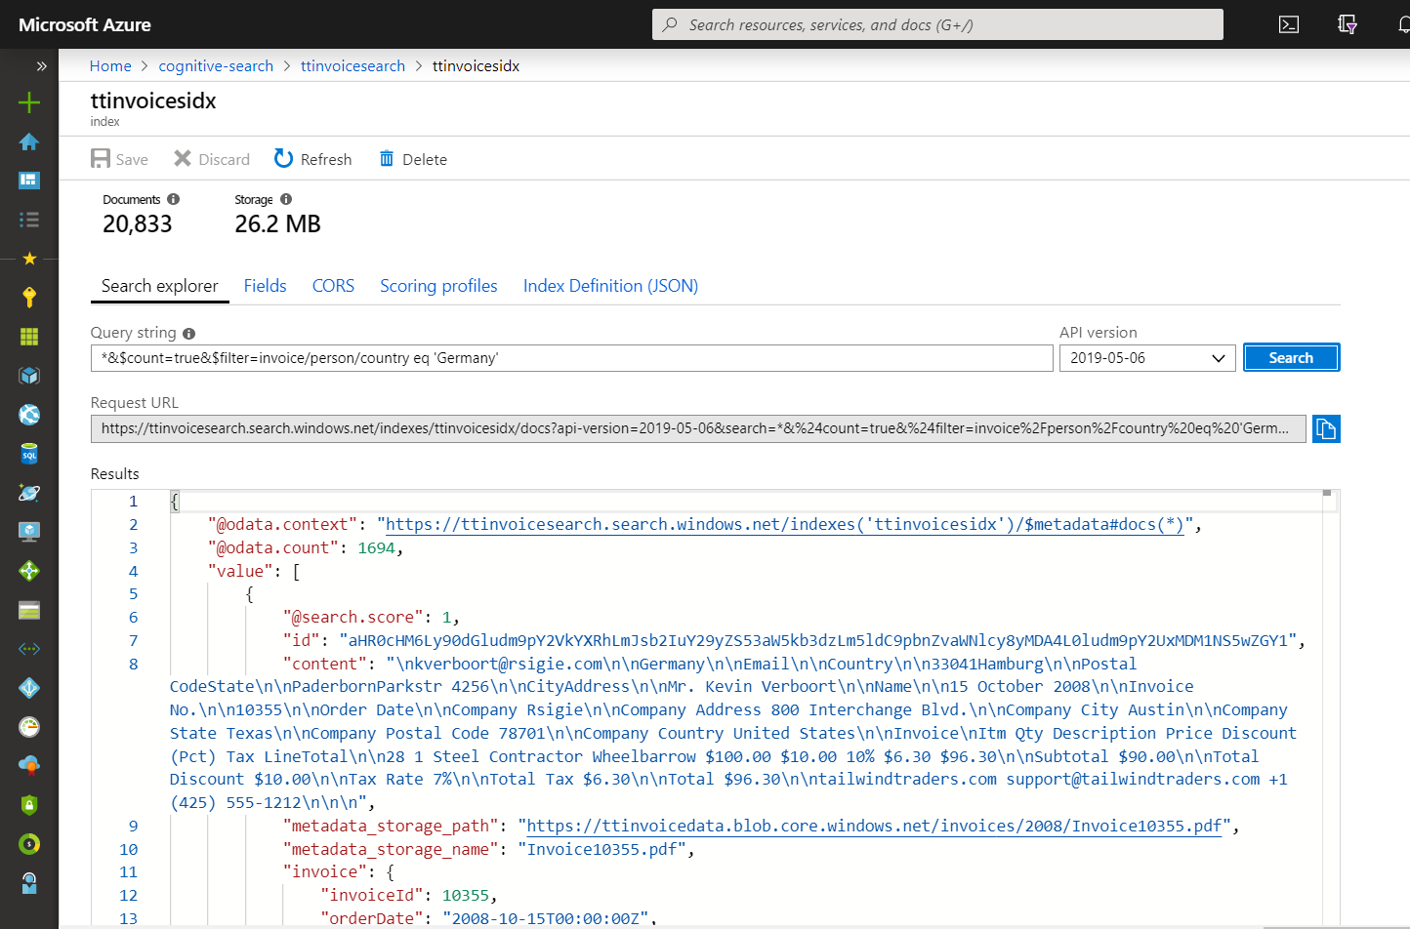
Explore
Types of search
Free form text
Filtered
Geo
Range
Fielded
fuzzy
proximity
term boosting
regular expression
wildcard or prefix
aka.ms/AIML10

Slide 51
Azure Cognitive Search
aka.ms/AIML10
aka.ms/iltaAI

Slide 52

What are we building in Azure Cognitive Search?
skillset
index
indexer
aka.ms/AIML10
aka.ms/iltaAI

Slide 53
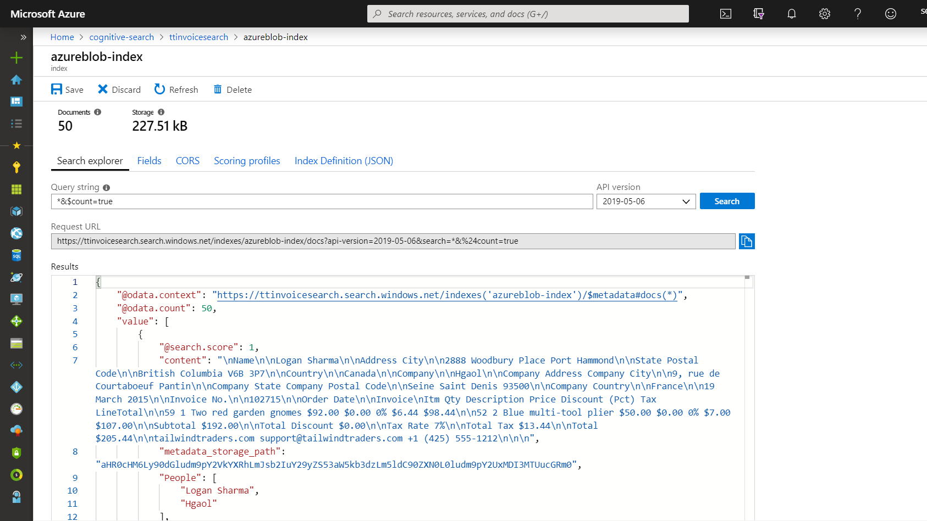

Slide 54




Azure Cognitive Search
IEnricher
IEnricher
Cognitive Skill
Document Cracking
Skillset:
Extensible enrichment
pipeline
Source Data
Enriched Documents
Search Index
Analytics
Retrieval
Projections
Knowledge Store
Machine Learning
Human Validation
aka.ms/AIML10

Slide 55
Azure Machine Learning Studio
A service that has all the tools needed to build amazing machine learning solutions.

Slide 56



Azure Machine Learning Service
Authoring tools: Automated ML, AML Designer, Notebooks and Files
Assets: Datasets, Experiments, Models, Deployments
Management: Compute, Datastores, Workspaces
aka.ms/iltaAI

Slide 57
machine learning
finding (and exploiting) patterns in data
replacing “human writing code” with “human supplying data”
starts with a sharp question
aka.ms/iltaAI

Slide 58
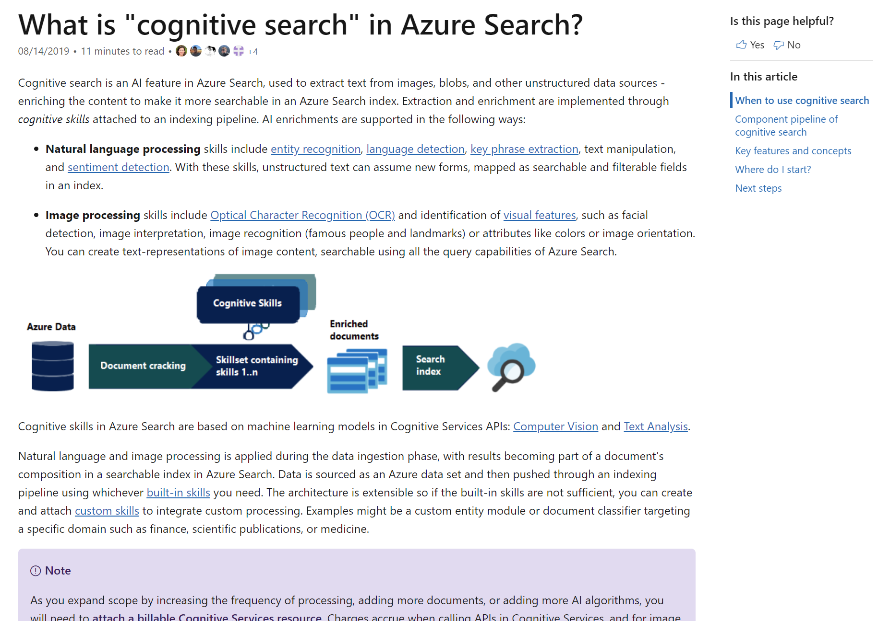
/Docs alert /Learn alert
Explore overviews, tutorials, samples, and more.
aka.ms/iltaAI
aka.ms/iltaAI

Slide 59
Thank you!
Cassie Breviu
Cloud Developer Advocate at Microsoft
@cassieview
aka.ams/iltaAI

